Slide 1
CS-468 Software Quality Assurance & Testing
Week 11
Session 2

Slide 2
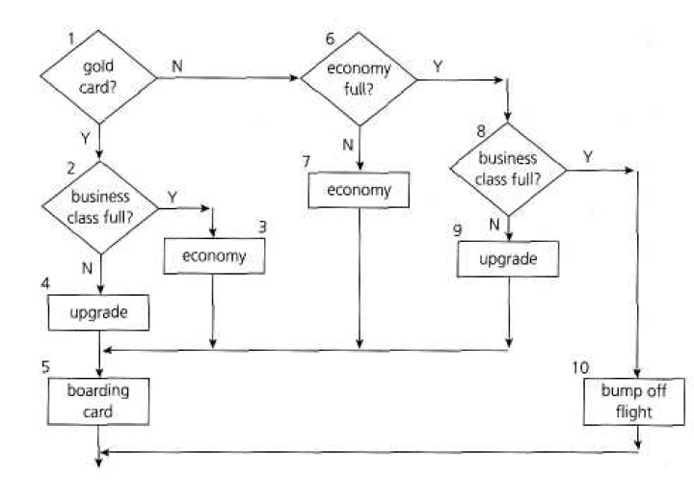
Control Flow Graph and Hybrid Flow Graph - Case Study
If you are flying with an economy ticket, there is a possibility that you may get upgraded to business class, especially if you hold a gold card in the airline's frequent flier program. If you don't hold a gold card, there is a possibility that you will get 'bumped' off the flight if it is full and you check in late? This is shown in following flow chart. Note that each box (i.e. statement) has been numbered.

Slide 3
Control Flow Graph and Hybrid Flow Graph - Case Study
Draw a control flow graph.

Slide 4
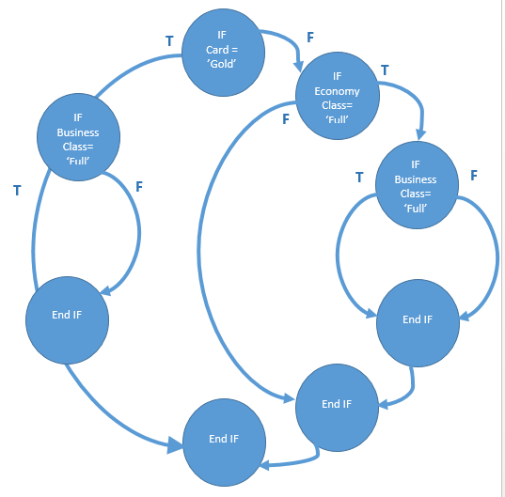
Control Flow Graph and Hybrid Flow Graph - Case Study

Slide 5
Control Flow Graph and Hybrid Flow Graph - Case Study
Generate a hybrid flow graph.

Slide 6
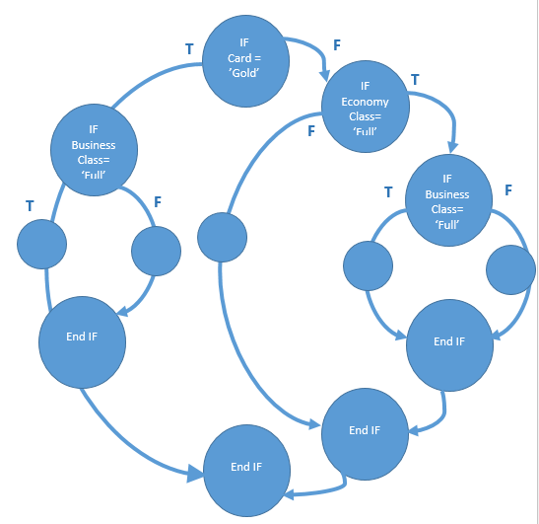
Control Flow Graph and Hybrid Flow Graph - Case Study

